Slide 1
CHAPTER 6
Risk, Return, & Capital Asset Pricing Model

Slide 2
Topics in Chapter
Basic return concepts
Basic risk concepts
Stand-alone risk
Portfolio (market) risk
Risk & return: CAPM/SML
Notes:
1

Slide 3
> Risk, > Return, (both + & -)
Stand – Alone Risk
Risk in Portfolio Context
a. Diversifiable
b. Market Risk
Quantified by Beta & used in
CAPM: Capital Asset Pricing Model
Relationship b/w market risk & required return as depicted in SML
Req’d return =
Risk-free return + Mrkt risk Prem(Beta)
SML: r_{i} = r_{RF} + (R_{M} - r_{RF} )b_{i}

Slide 4
What are investment returns?
Investment returns:
Returns may be either:
Returns can be expressed in:

Slide 5
Investment costs $1,000 & sold after 1 year for $1,100.
Dollar return:
$ Received - $ Invested
$ - $ = $
Percentage return:
$ Return/$ Invested
/ = 0.10 = 10%
Notes:
2

Slide 6
What is investment risk?
Typically, investment returns are not known with certainty.
Investment risk pertains to probability of earning a return less than expected.
Greater chance of a return far below expected return, greater risk.
Notes:
2

Slide 7
Risk & Return
Student Sue
Student Bob
Exam 1
80%
X weight
X 50%
Exam 1 x weight
50% x .50
Exam 2
X wt.
X
-----------
Exam 2 x wt
x
-------
Final grade =
Final grade =

Slide 8
Probability Distribution: Which stock is riskier? Why?

Slide 9
WedTech Co
Normal 40% Return 20% = .08
Bad 30% Return 5% = .015
Good 30% Return 35% = .105
=Expected ave return = 20%

Slide 10
WedTech Co
Standard Deviation: Measure of stand-alone risk
(Ret.-Exp Ret) = Diff² x Prob =
(.20 - .20) = 0² x .40 = 0
(.05 - .20) = <.15>² x .30 = .00675
(.35 - .20) = .15² x .30 = .00675
Variance: = .0135
SD: = .0135
Stand Dev: = 11.62%

Slide 11
Standard Deviation & Normal Distributions
1 SD =
2 SD =
3 SD =

Slide 12
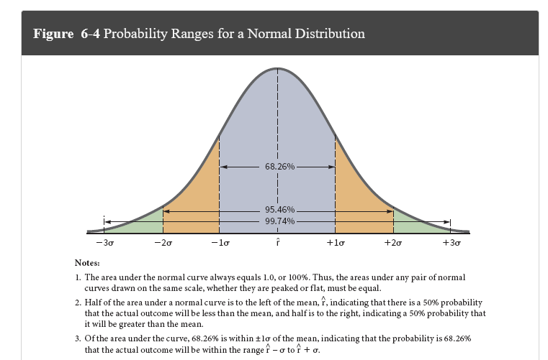
Standard Deviation & Normal Distributions

Slide 13
Stand-Alone Risk
Standard deviation measures
larger standard deviation:
Notes:
13

Slide 14
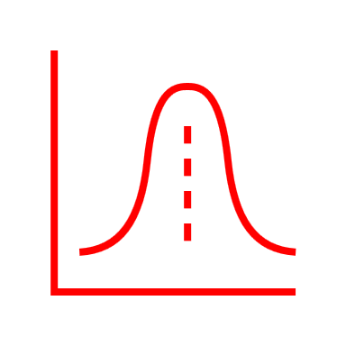
WedTech Graph

Slide 15
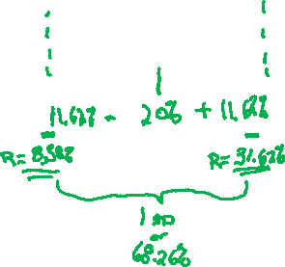
WedTech Graph

Slide 16
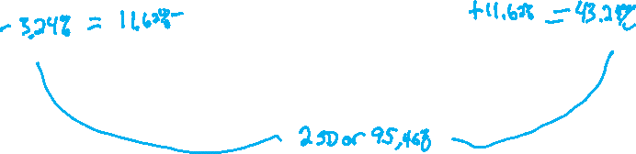
WedTech Graph

Slide 17
IBM
Normal 80% Return 12% = .096
Bad 10% Return 4% = .004
Good 10% Return 20% = .020
=Expected ave return = 12%
Standard deviation = measure of dispersion= 3.58%

Slide 18
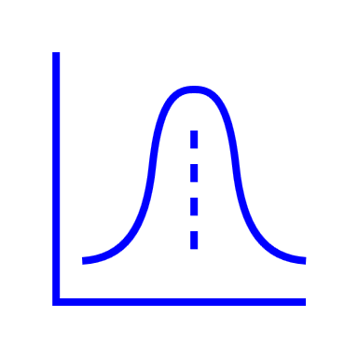
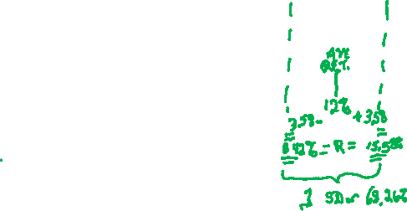
IBM Graph

Slide 19
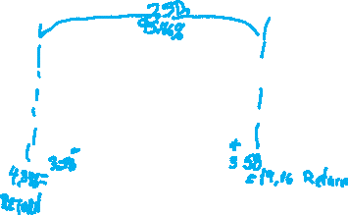
IBM Graph

Slide 20
IBM Graph

Slide 21
WedTech & IBM in 2 stock Portfolio
Ave Portfolio Return in 50%-50% split:
Ave Return %split
Wedtech 20% x .5 = 10%
IBM 12% x .5 = 6% Portf. Return = 16%
Portfolio Standard Deviation

Slide 22
Portfolio Standard Deviation
Consider returns of portfolio at various states of economy & associated probabilities
Will diversify away risk at higher rate than simple average of securities’ standard deviation

Slide 23
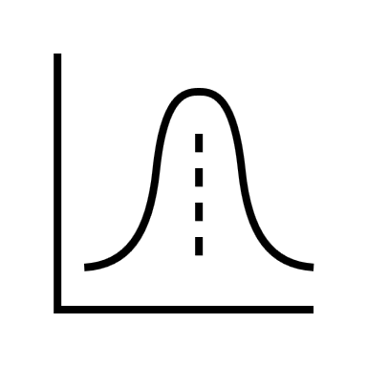
WedTech & IBM Portfolio

Slide 24
WedTech vs. IBM

Slide 25
WedTech & IBM in 2 stock Risk Averse Portfolio
Ave Portfolio Return in 20%-80% split
Ave Ret. %split
Wedtech 20% x .2 = 4%
IBM 12% x .8 = 9.6% Portf. Return = 13.6%
With even lower standard deviation

Slide 26
WedTech & IBM in 2 stock Risk Taker Portfolio
Ave Portfolio Return in 80%-20% split:
Ave Ret. %split
Wedtech 20% x .8 = 16%
IBM 12% x .2 = 2.4% Portf. Return = 18.4%
But greater Portfolio S.D. than other scenarios

Slide 27
WedTech & IBM: Adding other stocks to Portfolio
IBM WedTech
Coke Microsoft

Slide 28
Historical Risk vs. Return
Return: Hi – Lo
Risk: Hi - Lo
Small Co stock
Large Co Stock
LT Corp Bonds
LT Treasuries
ST T-Bills

Slide 29
Comparing Different Stocks
Coefficient of Variation:
= S.D. / Return or Risk / Return
WalMart vs. Philip Morris
12% Return 12%
12 S.D. 24
12 /12 = C.V. = 24 / 12
= 1 = C.V. = = 2
1 (unit of risk per unit return) 2

Slide 30
Comparing Different Stocks
Correlation coefficient = ρ (rho):
Measures tendency of 2 variables to move together
Rho (ρ) = 1

Slide 31
Two-Stock Portfolio
Two stocks can be combined to form riskless portfolio if rho (ρ):
Risk is not reduced at all if two stocks have:
In general, stocks have ρ ≈ 0.35, so:
Investors typically hold many stocks, not one!
Notes:
22

Slide 32
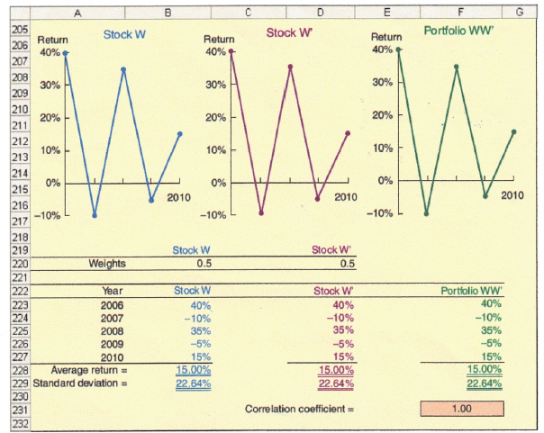
Two-Stock Portfolio: Perfect Positive Correlation (=+1.0)

Slide 33
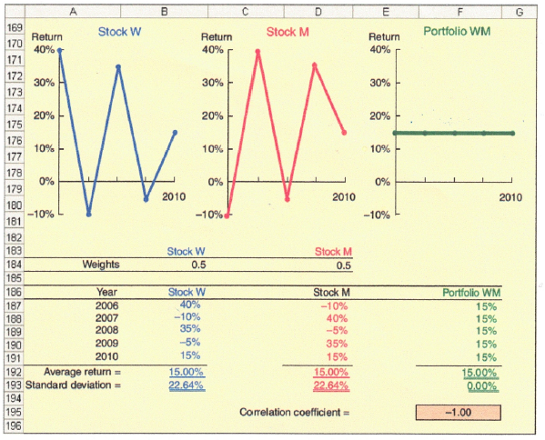
Two-Stock Portfolio: Perfect Negative Correlation (=-1.0)

Slide 34
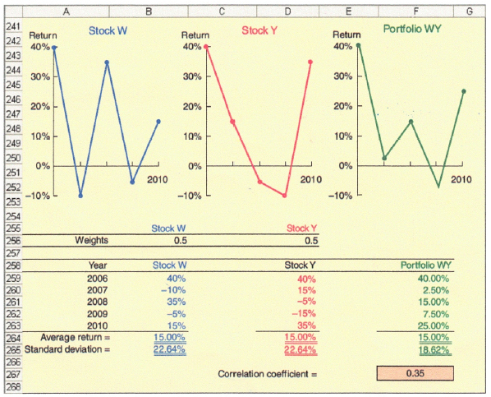
Two-Stock Portfolio: Historical Partial Correlation (= +0.35)

Slide 35
Adding Stocks to a Portfolio
What happens to risk of an average 1-stock portfolio as more randomly selected stocks added?
Portfolio Stand Dev. (σ_{p}) decreases b/c added stocks would not be perfectly correlated, but expected portfolio return would remain relatively constant.
Notes:
25

Slide 36
σ_{1 stock} ≈ 35% σ_{Many stocks} ≈ 20%

Slide 37
Risk vs. Number of Stock in Portfolio
σ_{p}
Company Specific (Diversifiable) Risk
35%
Stand-Alone Risk, σ_{p}
20%
0
Market Risk
10 20 30 40 2,000 stocks
Notes:
27

Slide 38
Stand-alone risk = Market risk + Diversifiable risk
Market risk is part of security’s stand-alone risk that
Firm-specific, or diversifiable, risk is part of security’s stand-alone risk that
Notes:
29

Slide 39
Conclusions
As more stocks are added, each new stock has a
σ_{p} falls very slowly after about 40 stocks added
lower limit for σ_{p} is about 20%
By forming well-diversified portfolios, investors can:
Notes:
31

Slide 40
Can an investor holding one stock earn a return commensurate with its risk?
No. Rational investors minimize risk by holding portfolios.
They bear only market risk, so prices & returns reflect this lower risk.
One-stock investor bears higher (stand-alone) risk, so return is less than required by risk.
Notes:
32

Slide 41
How is market risk measured for individual securities?
Market risk –
Which is relevant for stocks held in well-diversified portfolios, is the:
Measured by a stock’s beta coefficient.
Beta is found by
Notes:
34

Slide 42
Beta Measurements
In addition to measuring a stock’s contribution of risk to a portfolio, beta also measures stock’s
Remember:

Slide 43
How is beta interpreted?
If b = 1.0, stock has:
If b >1.0, stock is:
If b < 1.0, stock is:
Most stocks have betas in range:

Slide 44
Using a Regression to Estimate Beta
Run regression plotting
Slope of regression line:
Notes:
35

Slide 45
Use historical stock returns to calculate beta for PQU
Year |  | Market |  | PQU
1 |  | 25.7% |  | 40.0%
2 |  | 8.0% |  | -15.0%
3 |  | -11.0% |  | -15.0%
4 |  | 15.0% |  | 35.0%
5 |  | 32.5% |  | 10.0%
6 |  | 13.7% |  | 30.0%
7 |  | 40.0% |  | 42.0%
8 |  | 10.0% |  | -10.0%
9 |  | -10.8% |  | -25.0%
10 |  | -13.1% |  | 25.0%

Slide 46
Calculating Beta for PQU

Slide 47
Beta & PQU Co.
Beta reflects slope of line via regression
y = mx + b
m=slope + b= y intercept
R_{pqu} = 0.8308 r_{M} + 0.0256
So, PQU’s beta is .8308 & y-intercept @ 2.56%

Slide 48
Beta & PQU Co. & R2
R² measures degree of dispersion about regression line (ie – measures % of variance explained by regression equation)
PQU’s R² of .3546 means about 35% of PQU’s returns are explained by market returns (32% for a typical stock)
R² of .95 on portfolio of 40 randomly selected stocks would reflect a regression line with points tightly clustered to it.

Slide 49
Calculating Beta in Practice
Many analysts use S&P 500 to find market return
Analysts typically use 4 or 5 years of monthly returns to establish regression line.
Some use 52 weeks of weekly returns.

Slide 50
Capital Asset Pricing Model
Security Market Line (SML) is part of Capital Asset Pricing Model (CAPM).
Return = Risk Free + Beta (RetMrkt –Rf)
SML: r_{i} = r_{RF} + b_{i} (R_{PM})
Notes:
43

Slide 51
Graph of Security Market Line

Slide 52
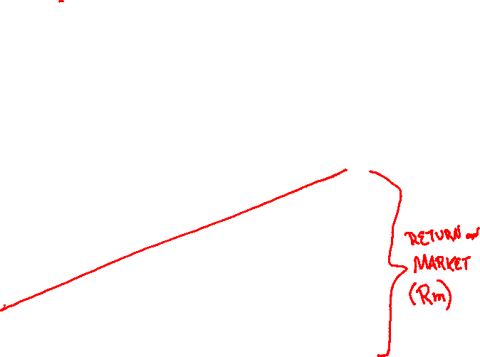

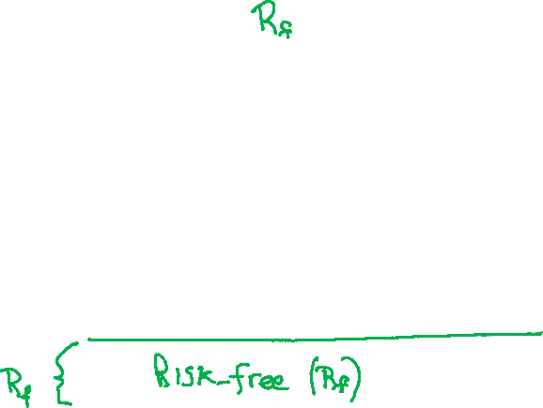
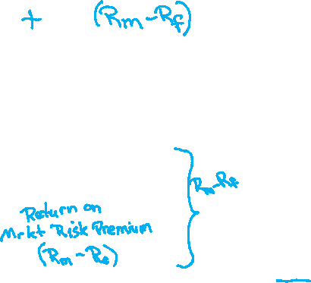
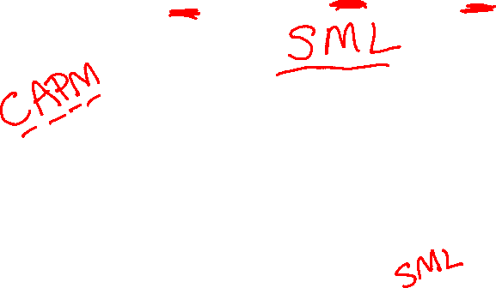
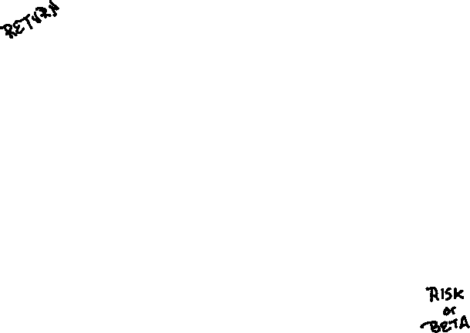
Graph of Security Market Line

Slide 53
Using SML to calculate required return
Security Market Line (SML) is part of Capital Asset Pricing Model (CAPM).
SML: return = risk-free return + Beta(Market risk premium) .
Assume T-Bill = 7% = r_{RF};
= Return on market =15% = r_{M}
Then:
Market Risk premium = RP_{M} = (r_{M} - r_{RF}) = 15% - 7% = 8%.
Notes:
43

Slide 54
SML to calculate required return.
If company’s Beta = 1.25
Then: R = Rrf + B ( Rm – Rf).
R = .07 + 1.25 (.08) = 17%
Req’d return = 17% vs.
Expected return of 13%
Go / No Go ?
No Go, it’s overvalued!
Notes:
43

Slide 55
Expected Return versus Market Risk: Which investment is best?
Security |  | Expected Return (%) |  | Risk, b
Alta |  | 17.4 |  | 1.29
Market |  | 15.0 |  | 1.00
Am. Foam |  | 13.8 |  | 0.68
T-bills |  | 8.0 |  | 0.00
Repo Men |  | 1.7 |  | -0.86

Slide 56
Required Rates of Return
If T-bill =8%, & MRP = 7%
Then required rates of return=
Return = Risk Free + Beta (RM –Rf)
SML: r_{i} = r_{RF} + b_{i} (R_{PM})
r_{Alta} = 8.0% + (7%)(1.29) = 17%.
r_{M} = 8.0% + (7%)(1.00) = 15.0%.
r_{AmF.} = 8.0% + (7%)(0.68) = 12.8%.
r_{T-bill} = 8.0% + (7%)(0.00) = 8.0%.
r_{Repo} = 8.0% + (7%)(-0.86) = 2.0%.

Slide 57
Expected versus Required Returns (%)
 | Exp. |  | Req.
 | r |  | r
Alta | 17.4 |  | 17.0 | Undervalued
Market | 15.0 |  | 15.0 | Fairly valued
Am. Foam | 13.8 |  | 12.8 | Undervalued
T-bills | 8.0 |  | 8.0 | Fairly valued
Repo | 1.7 |  | 2.0 | Overvalued

Slide 58
SML: r_{i} = r_{RF} + (RP_{M}) b_{i} r_{i} = 8% + (7%) b_{i}
r_{i} (%)
.
Alta
Market
.
.
r_{M} = 15
r_{RF} = 8
.
Am. Foam
.
T-bills
Repo
Risk, b_{i}
-1 0 1 2
Notes:
46

Slide 59
Calculate beta for 2-stock portfolio: 50% Alta & 50% Repo
b_{p} = Weighted average
= 0.5(b_{Alta}) + 0.5(b_{Repo})
= 0.5(1.29) + 0.5(-0.86)
= 0.22.
Notes:
47

Slide 60
Required Return on 2-stock portfolio: 50% Alta & 50% Repo
r_{p} = Weighted average r
= 0.5(17%) + 0.5(2%) = 9.5%.
Or use SML:
r_{p} = r_{RF} + (RP_{M}) b_{p}
= 8.0% + 7%(0.22) = 9.5%.
Notes:
48

Slide 61
Impact of Inflation Change on SML
r (%)
New SML
Δ I = 3%
SML₂
18
15
11
8
SML₁
Original situation
0 0.5 1.0 1.5 Risk, b_{i}
Notes:
50

Slide 62
Impact of Risk Aversion Change
r (%)
SML₂
After change
18
15
SML₁
Δ RP_{M} = 3%
Original situation
8
Risk, b_{i}
1.0
Notes:
52

Slide 63
Has CAPM been completely confirmed or refuted?
No. statistical tests have problems that make empirical verification or rejection virtually impossible.
Investors’ required returns are based on future risk, but betas are calculated with historical data.
Investors may be concerned about both stand-alone & market risk.
Notes:
53

